Slide 1

The Goal-Gradient Effect in UX Design
An Overview of UX Principles and Motivational Design
Presented by, Anslem Peter Coelho, Samson Maveli Mathews, Rahul

Slide 2

What is the Goal-Gradient Effect?
The tendency to approach a goal increases with proximity to the goal.

Slide 3
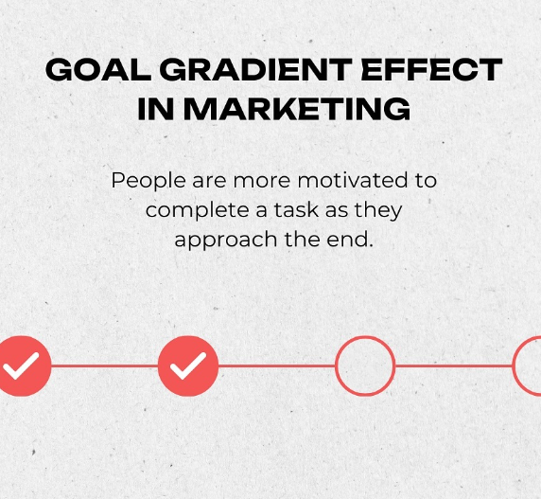
How to use the Goal Gradient in UX
Progress bar
Checklist
Milestone

Slide 4

Problems the Law Solves in UX Design
Motivation Boost: Keeps users engaged by showing progress.
Reduced Drop-Off: Minimizes task abandonment.
Clear Pathways: Users know where they are in a multi-step process.

Slide 5
Example: Good UX Designs
Duolingo.com
Feature: Daily streak, XP progress bar, and skill trees.
Why It Works: Users see tangible progress and are encouraged to continue learning.

Slide 6
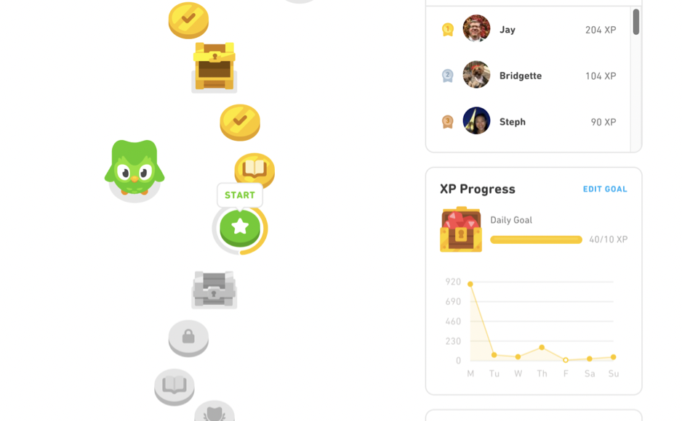

Slide 7
Example: Good UX Designs
LinkedIn.com
Feature: Profile strength meter
Why It Works: Visual indicator of how complete a user’s profile is increases profile completion rates.

Slide 8
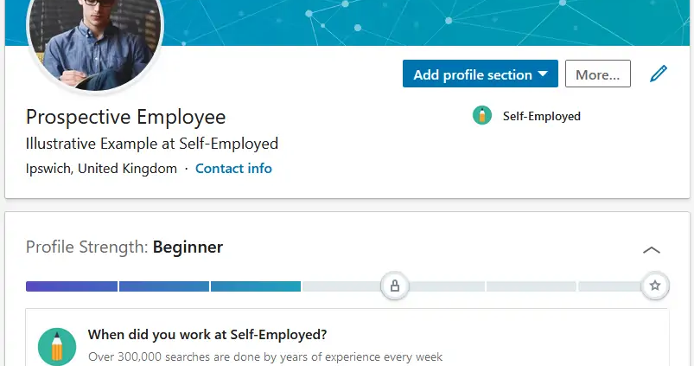

Slide 9
Example: Bad UX Application
CRA forms
Issue: Multi-step processes with no progress bar.
Why It Fails: Users don’t know how long the task is, leading to frustration and abandonment.

Slide 10
Example: Bad UX Application
Checkout on outdated platforms
Issue: Long checkout flow without step indicators.
Why It Fails: Lack of feedback reduces user confidence.
A google form link

Slide 11
Conclusion
Improves user motivation, reduces abandonment, and enhances the overall experience.
Progress indicators, reward systems, and visual cues guide users to the finish line.

Slide 12
THANK YOU

